Slide 1
Please attribute as SimpleITK Historical Overview
This work is copyrighted by the NumFOCUS
It is distributed under a Creative Commons Attribution 4.0 International License: https://creativecommons.org/licenses/by/4.0/

Slide 2
SimpleITK: Standing on the Shoulders of Giants

Slide 3
What is SimpleITK?
An open-source multi-dimensional image analysis toolkit with a simplified multi-language interface to the Insight Toolkit (ITK).
Available in:
C++, Python, R, Java, C#, Lua, Ruby, TCL
github.com/SimpleITK/SimpleITK

Slide 4
Copyright and License
SimpleITK is part of the Insight Software Consortium a non-profit educational consortium dedicated to promoting and maintaining open-source, freely available software for medical image analysis.
Copyright held by NumFOCUS.
Distributed under the Apache License 2.0.

Slide 5
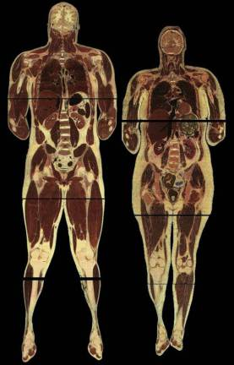
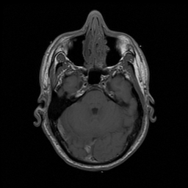
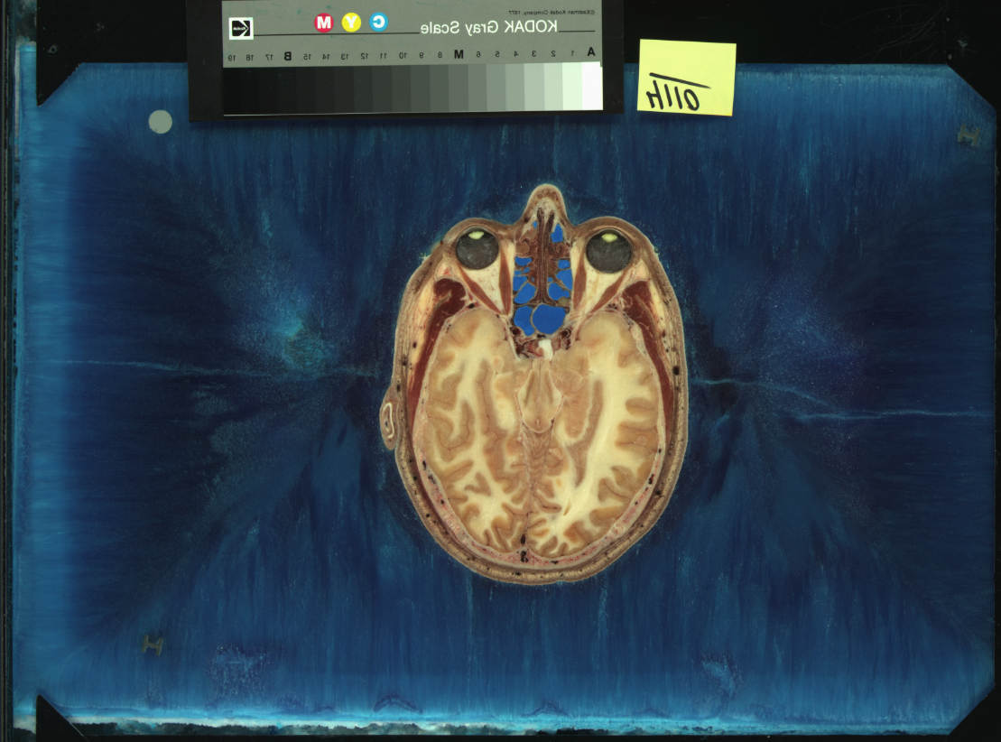
In the Beginning There Was Data
Male ~ 15Gb (21CDs)
Female ~ 40Gb (58CDs)
Dialup ~ 28.8Kbps (51 days to download the male dataset).
“The Visible Human Male: A Technical Report", V. Spitzer et al., J. Am. Med. Inform. Assoc.,3(2), pp. 118-130, 1996.

Slide 6
In the Beginning There Was Data
Data was Findable, Accessible, Interoperable and Reusable (FAIR) before the concept existed.
Download it from NLM.
“The FAIR Guiding Principles for scientific data management and stewardship", M. D Wilkinson et al., Sci Data, 3:160018, 2016.

Slide 7
Need to Analyze the Data
2002
2018/2020
Insight Segmentation and Registration Toolkit
Insight Toolkit
Insight Software
Consortium
&
“Engineering and Algorithm Design for an Image Processing API: A Technical Report on ITK - the Insight Toolkit”, T. S. Yoo et al., Stud. Health Technol. Inform., 85, pp. 586-592, 2002.

Slide 8
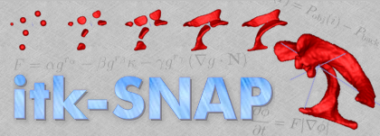
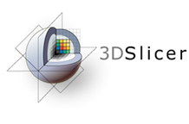
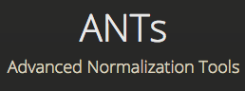
Open Source

Slide 9
Commercial Entities
Based on mailing list – Likely.
But we have no written testimony.

Slide 10
Why SimpleITK
Change in programming expertise:
Python, R, C#.
Change in expectations:
No need to compile/build software.
Software should be easy to install.
Language Rank | Spectrum Ranking
1. Python | 100.0
2. C | 96.8
3. C++ | 88.58
4. C# | 86.99
5. Java | 70.22
6. SQL | 47.37
7. JavaScript | 40.48
8. R | 18.92
9. HTML | 17.97
10. TypeScript | 16.99
✓
✓
✓
✓
✓
“The 2022 Top Programming Languages”, IEEE Spectrum, S. Cass.

Slide 11
Simplified Data Analysis
2011-2018
2019 -

Slide 12
Releases
Total number of releases: 37
Two major releases (1.0.0 – 2017, 2.0.0 – 2020)
Latest release: 2.2.0 – 8/2022.
Latest development binaries available from GitHub: pip install --upgrade --pre SimpleITK --find-links https://github.com/SimpleITK/SimpleITK/releases/tag/latest

Slide 13
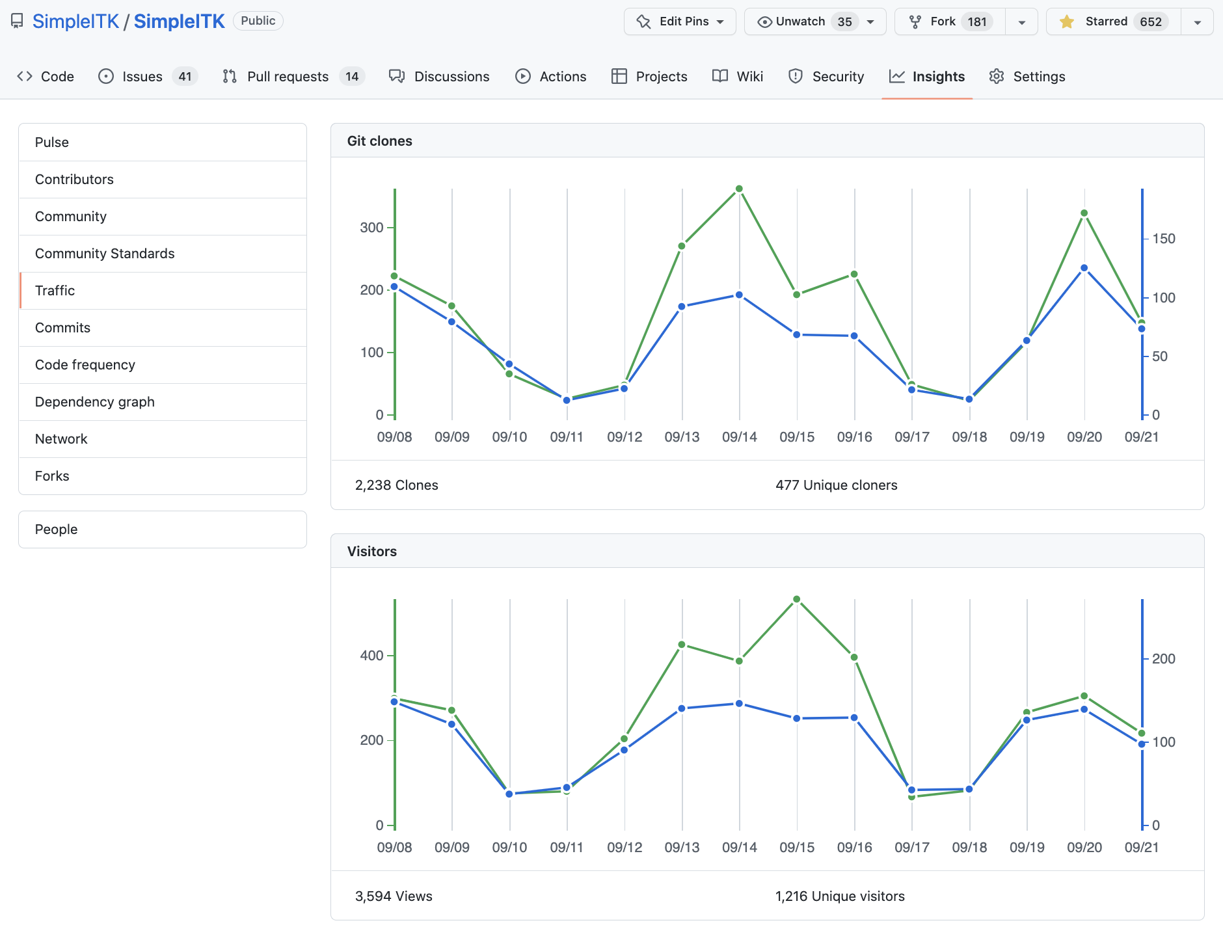
SimpleITK by the Numbers
A week in 9/2022:
47 Contributors.
8201 Commits.
227250 lines of code.
Starred on GitHub: main repository > 650, notebook repository >665.
More than 87,000 downloads from pypi in 8/2022.
Notes:
Release tags: git tag
Number of contributors: git log --format='%aN' | sort -u -k2; then count and remove people with multiple appearances (Dave Chen, David T. Chen…)
Number of commits in repo: git rev-list --all --count
Lines in repository: git ls-files | xargs wc -l

Slide 14
How to Support
Cite us:
Beare, B. C. Lowekamp, Z. Yaniv, “Image Segmentation, Registration and Characterization in R with SimpleITK”, J Stat Softw, 86(8), https://doi.org/10.18637/jss.v086.i08, 2018.
Z. Yaniv, B. C. Lowekamp, H. J. Johnson, R. Beare, "SimpleITK Image-Analysis Notebooks: a Collaborative Environment for Education and Reproducible Research", J Digit Imaging., https://doi.org/10.1007/s10278-017-0037-8, 31(3): 290-303, 2018.
B. C. Lowekamp, D. T. Chen, L. Ibáñez, D. Blezek, "The Design of SimpleITK", Front. Neuroinform., 7:45. https://doi.org/10.3389/fninf.2013.00045, 2013.
Star us on GitHub:
Main repository – github.com/SimpleITK/SimpleITK
Notebook repository – github.com/InsightSoftwareConsortium/SimpleITK-Notebooks

Slide 15
Join the Community
We welcome questions/requests/contributions from the community:
Ask questions (itk discourse)
Request features / examples.
Report bugs.
Contribute code or new notebooks.
github.com/SimpleITK/SimpleITK
and
github.com/InsightSoftwareConsortium/SimpleITK-Notebooks

